Slide 1

Sales & Profit Performance
Presented by
N. Sri Charan

Slide 2

Objective
This dashboard analyzes sales and profit performance across products, segments, and countries, using the Superstore dataset. It aims to provide insights into total sales, profit margins, and product performance.

Slide 3
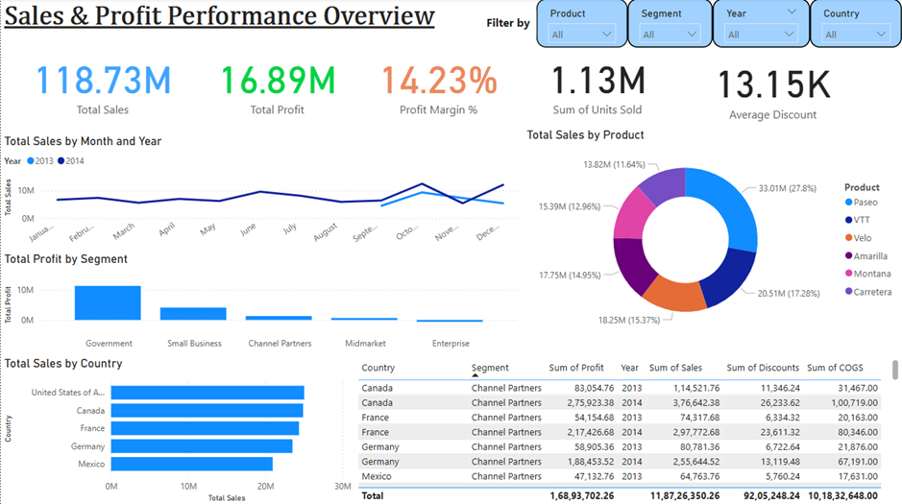
Power BI Dashboard
Slicers
KPI
KPI
KPI

Slide 4

Key Metrics
Total Sales :- 118.73M
The total revenue generated from all product sales.
Total Profits :- 16.89M
The amount earned after subtracting the cost of goods sold (COGS) from total sales.
Profit Margin :- 14.23%
Units Sold :- 1.13M
The total number of product units sold across all segments and countries.

Slide 5
Insights from Visualizations
Sales Trend Over Time
Top Products by Sales
Profit by Segment
Country-Level Performance

Slide 6
Dashboard Design Strategy
1. Clean & Logical Layout
2. Colour Theme Consistency
3. Effective Chart Types
4. Slicer Panel for Interactivity
5. User-Focused Enhancements

Slide 7

Conclusion & Final Takeaways
🎯 Business Impact :-
Provides a quick snapshot of business health through KPIs. Helps identify top-performing products and high-profit segments.
Enables stakeholders to filter data instantly and make data-driven decisions. Reveals patterns in sales trends and discount usage for strategy planning.

